Slide 1
Test Theory – Classical & Modern (How we get scores for our tests)
Gavin T L Brown, PhD
Seminar at EARLI SIG 1 Summer School, August 2018, Helsinki, Finland

Slide 2
Overview
Philosophic and practical issues
Difficulty, discrimination, & chance
Classical Test (True Score) Theory
Item Response Theory (Rasch, 2PL, and 3PL)

Slide 3
Assumptions in Measurement
If something exists we can measure it
If we can’t measure it, we may have failed in our ingenuity and ability to measure—it doesn’t mean the thing doesn’t exist
We have an unfortunate tendency to treat as valuable only the things we can measure
We tend to treat as value-less anything we can’t measure even if it does have value

Slide 4
Assumptions in Measurement
All measures have some error
The length of a certain platinum bar in Paris is a metre
It is supposed to be 1/10,000,000th of the distance from equator to pole
but it is short by 0.2 mm according to satellite surveys
Less error in measures of physical phenomena and more in social phenomena

Slide 5
Assumptions in Measurement
Reality has patterns partly because random chance has patterns in it
Toss a coin enough times and you will get patterns like this:
T H T T H H T T T H H H T T T T H H H H
OR
T T T T T T T H H H H H H H
If you measure something often enough, one of your results will appear to be non-chance, even though it actually is a chance event

Slide 6
Assumptions in Measurement
Chance plays a significant part in the results we generate
Sometimes the result we get could occur by chance anyway; just because something happens doesn’t mean it would not have occurred anyway
If it is relatively unlikely to occur by chance then we say it is “Statistically significant”
So we create tables of how often things occur by chance as a reference point
We can estimate the probability (p) of something happening by chance and use this to determine whether our result is real or a chance artifact

Slide 7
Measuring Human mental properties
Problem of measuring stuff ‘in-the-head’
Our mental actions are difficulty to observe directly
How do we know how much xxx you have?
Measure xxx with a recognised tool
Measuring Tools for Social Science
Answers to Questions (paper or oral)
Self-reports
Observational Check Lists
What scale properties do tools like these have?

Slide 8
Test Scores
Answers are marked as right =1, wrong=0
Categorical/Nominal labelling of each response
Tests use the sum of all answers marked as right to indicate total score
1,0,1,1,1,0,0,0,1,0=5/10: A continuous, numeric scale
What other factors might be at work and how do we account for them?
Difficulty of items, quality of items, probability of getting an item right despite low knowledge, varying ability of people

Slide 9
Defining the construct
How much of a specified domain do you know or can you do?
>80%=A
65-79%=B
50-65%=C
<49%=D
How well do you know the content and skills you are supposed to learn?
A=Excellent
B=Good
C=Satisfactory
D=Unsatisfactory
Quantity
Quality

Slide 10
The multiple meanings of test scores
Observed—What you actually get on a test
True—The score you are likely to get taking into account uncertainty and error in our estimation.
Ability—What you really are able to do or know of a domain independent of what’s in any one test
Ability
O
True Score Range

Slide 11
How Tests & Scores Relate
Ability is relatively constant or invariant; only changes gradually with learning & teaching (test independent)
True Score varies depending on difficulty of items selected in test (test dependent)
Observed scores vary dependent on quality of items and their accuracy in measuring the construct (test dependent)
What we know about items depends on the sample of examinees they are tested on

Slide 12
Two Major Models
Classical Test Theory (CTT)
Served test industry well for most of 20th century
Relatively weak theoretical assumptions – easy to meet
Easy to apply – hand calculated statistics, but
Major limitations
Focus at TEST level
Item Response Theory (IRT)
‘Modern’ test theory
Strong theoretical assumptions … but may not always be met!
Requires computers to apply
Focus at ITEM level

Slide 13
Test Scores: The problem
Students A, B and C all sit the same test
Test has ten items
All items are dichotomous (score 0 or 1)
All three students score 6 out of 10
What can we say about the ability of these three students?

Slide 14
CTT Scores
Assumptions: Each item is equally difficult and has equal weight towards total score. Total score based on sum of items correct is a good estimate of true ability
Inference: these students are equally able.
But what if the items aren’t equally difficult?

Slide 15
Classical Approach
TEST
item
All items in test are like bricks in a wall held together by mortar of the total impact of the test
Items only mean something in context of the test they’re in
item
item
item
item
item
item
item
All items have equal weight in making up test statistics and scores

Slide 16
Classical Test Theory
All items are random sample of domain being tested
Core total test statistics are:
the average test score (mean)
The spread of scores (standard deviation)
The distribution of items to people (discrimination)
All statistics for persons and items are sample dependent
Requires robust representative sampling (expensive, time consuming, difficult)
Classrooms are not large or representative; schools might be
Total Score is simply sum of number of items answered correctly

Slide 17
Two key quality parameters test items
How hard is the item?➔Item Difficulty (p):
% of people who answered correctly
Mean correct across people is p
Applications
generalised ability test➔usually delete items too easy (p>.9) or too hard (p<.1) for
A mastery test➔maximise items that fit the difficulty of the cut score (e.g., p=.35, which means 65% correct)
Item Difficulty
#no new library has to be invoked these are part of base package
#use na.rm=true only if missing data present, otherwise drop
item_diff<-colMeans(MTcsv_noID, na.rm=true)
round(item_diff, 3)
V1 | V2 | V3 | V4 | V5
0.787 | 0.392 | 0.379 | 0.552 | 0.571

Slide 18
Item Discrimination r_{pb}
Who gets the item right?➔Item Discrimination
Correlation between each item and the total score without the item in it
If the item behaves like the rest of the test the correlation should be positive (i.e., students who do best on the test tend to get each item right more than people who get low total scores)
Ideally, look for values > .20
Beware negative or zero discrimination items, otherwise the item might be testing a different construct or else the distractors might be poorly crafted

Slide 19
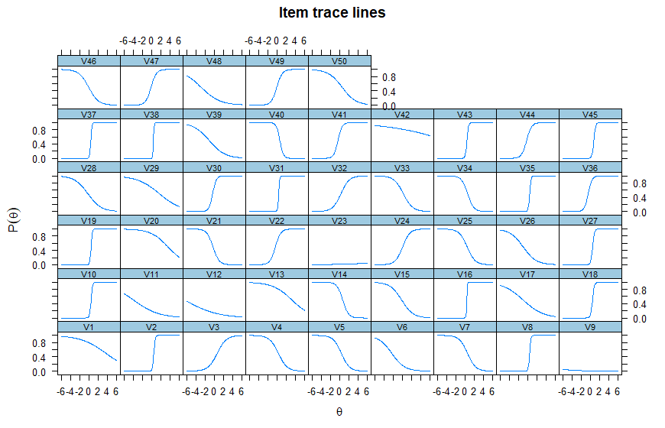
Discrimination slopes
Bottom right to top left = GOOD

Slide 20
Test Creation: CTT
Select items that
correlate well with each other (.30--.80)
have similar difficulty (around p=.50)
high discrimination
Item Discrimination
##first create a total score for each person
total_score<-rowSums(MTcsv_noID)
##correlate each item with the total score
item_discr<-cor(MTcsv_noID, total_score)
##display item discrimination values
item_discr
[,1]
V1 0.012824108
V2 0.535991439
V3 0.322218523
V4 0.120527496
V5 0.094385108….

Slide 21
Selecting Items for Test: Using difficulty and discrimination
ITEMS
All items acceptable difficulty
Need many more students to have confidence in measurements
Poor items:
Q1 (reverse discrimination) Q2 (zero discrimination)
Student | Q1 | Q2 | Q3 | Q4 | Q5 | Tot.
1 | 1 | 1 | 0 | 0 | 0 | 2
2 | 1 | 0 | 1 | 1 | 0 | 3
3 | 0 | 1 | 1 | 1 | 1 | 4
Diff p | .67 | .67 | .67 | .67 | .33
Disc r | -.87 | .00 | .87 | .87 | .87

Slide 22
Evaluating a Test: CTT
Calculate Descriptive Statistics
M = 3; SD = 1;
Calculate Inferential Statistics
Cronbach alpha estimate of reliability = .833;
sem = 1*√1-.833 = .41
Implications:
Student’s True Score estimated e.g., Student 3 T= 4+/-.41 = 3.59—4.41
Consistency of items >.80; so with this sample this is a good test

Slide 24
Major limitations of CTT
Dependency on test and item statistics
Indices of difficulty and discrimination are sample dependent
change from sample to sample
Trait or ability estimates (test scores) are test dependent
change from test to test
Comparisons require parallel tests or test equating – not a trivial matter
Reliability depends on SEM, which is assumed to be of equal magnitude for all examinees (yet we know examinees differ in ability)

Slide 25
Summary of CTT
All statistics for persons, items, and tests are sample dependent
Requires robust representative sampling (expensive, time consuming, difficult)
Items have equal weight towards total score
Easy statistics to obtain & interpret for TESTS only
Has major limitations, however

Slide 26
Item Response Theory (IRT)
Rethink items and tests because of CTT weaknesses
Often called “latent trait theory” –
assumes existence of unobserved (latent) trait OR ability which leads to consistent performance
Focus at item level, not at level of the test
Calculates parameters as estimates of population characteristics, not sample statistics

Slide 27
Goals of IRT
Generate items that provide maximum information about the proficiency/ability of interest
Give examinees items tailored to their proficiency/ability
Reduce the number of items required to pinpoint an examinee on the proficiency/ability continuum (without loss of reliability)

Slide 28
Item Response Theory
All items like $c in a bank
Different denominations have different purchasing power ($5<$10<$20….)
All coins & bills on same scale
Can be assembled into a test flexibly tailored to the ability or difficulty required AND reported on a common scale
All items in test are systematic sample of domain
All items in test have different weight in making up test score

Slide 29
IRT Assumptions
Probability of getting an item correct is a function of ability—P_{i}(θ)
as ability increases the chance of getting item correct increases
People and items can be located on one scale
Item statistics are invariant across groups of examinees
S-shaped curves (ogive) plot relationship of parameters
More than one model for accounting for error components

Slide 30
Items and People on same scale
Items of varying difficulty
- ∞
∞
People of varying ability

Slide 31

Ogive
A term used to describe a round tapering shape

Slide 32
Probability of getting an item right
Probability does NOT increase in linear fashion
Item x
Chance of getting it right increasing
Probability increases in relation to ability, difficulty, and chance factors in an ogive fashion
Ability & Difficulty Increasing

Slide 33
Three IRT Parameters
Difficulty:
the ability point at which the probability of getting it right is 50% (b)
Note in 1PL /Rasch this is the ONLY parameter
Discrimination:
The slope of the curve at the difficulty point (a)
Pseudo-Chance:
The probability of getting it right when no TRUE ability exists (c)

Slide 34
Three IRT Models
1PL (Rasch)
only uses b parameter; no c; and a set equal for all items
2PL
uses b and a, ignores c
3PL
uses a, b, and c
Choice depends on theory and fit statistics (note many objectively scored tests use 1PL to calculate test scores but many developers use 2PL and 3PL to evaluate items before tests are created)

Slide 35
IRT - the generalised model
Where
_{g} = an item on the test
a_{g} = gradient of the ICC at the point θ (item discrimination)
b_{g} = the ability level at which a_{g} is maximised (item difficulty)
c_{g} = probability of low candidates correctly answering question g
e = natural log, ≈2.718
D = scaling factor to make logistic function close to ogive, =1.7
Rasch model remove c, D, and a

Slide 36
Estimating a Score
IRT creates estimate of ability based on how hard the items were that the student got right
Creates estimate of where the student has a 50% chance of getting items correct
Note more items answered correctly at the same difficulty point only increases accuracy of estimate, not the estimate of ability

Slide 37
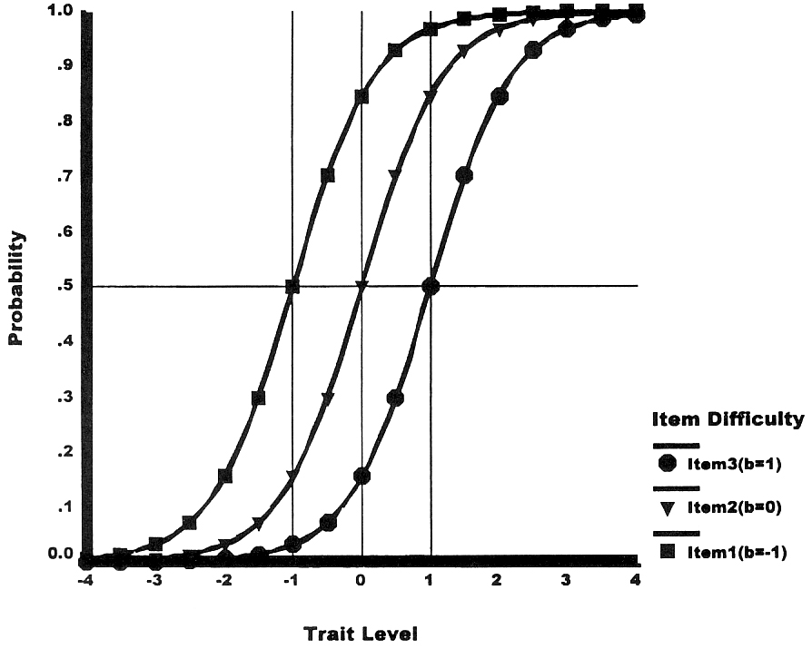
1PL Item Characteristic Curve (ICC)
Difficulty found at 50% probability
Slopes identical
NO Chance parameter

Slide 38
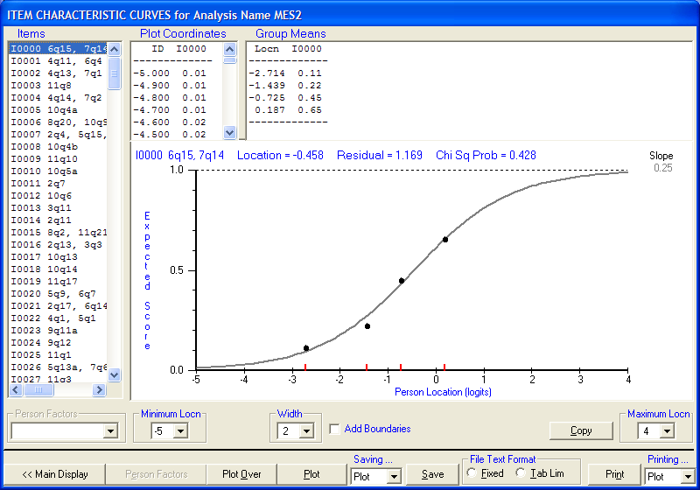
1PL Good Fit
Distribution of population into ability groups relative to 1PL fixed discrimination curve.
Fit of people to item good.

Slide 39
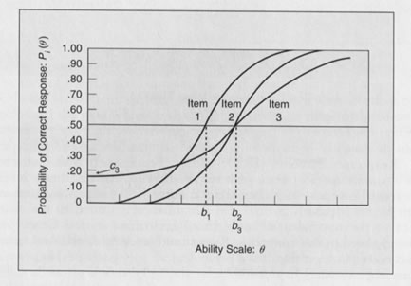
2PL & 3PL Item Characteristic Curves
SLOPES not the same
Difficulty found at 50% probability
CHANCE possible

Slide 40
Key Properties of IRT
Probabilistic - determines the probability that an examinee with ability θ correctly answers the item
Identifies how well data fits the model
Identifies which items to reject before score calculation
Estimates item parameters and person ability on same scale
Sample independent

Slide 41
Equal scores but what if the items are not equal….so?

Slide 42
CTT and IRT Test Scores Compared
Conclusions: C > A, B; B ≈ A because C answered all the hardest items correctly—no penalty for skipping or getting easy items wrong

Slide 43
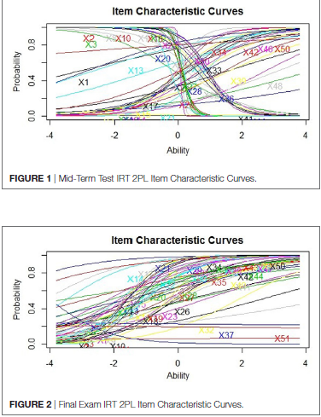
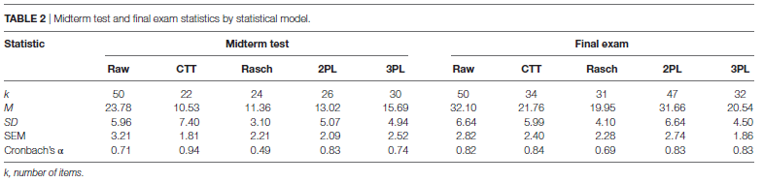
2 real University Tests
Many items in the mid-term were not good, most in the final exam were good, so not all equally well-written
Brown, G. T. L., & Abdulnabi, H. (2017). Evaluating the quality of higher education instructor-constructed multiple-choice tests: Impact on student grades. Frontiers in Education, 2(24). doi:10.3389/feduc.2017.00024

Slide 44
Tutorial
Install R; R Studio
(if you haven’t got them already)
Install packages
psych, ltm
Download data file
https://figshare.com/s/84263075944322e54036
Open “Analysing a test with packages in R” tutorial document
https://figshare.com/s/aa594e1913d00fe02852
Let’s go….

Slide 45
Extra readings
Baker, F. B. (2001). The Basics of Item Response Theory (2nd ed.). College Park, MD: ERIC Clearinghouse on Assessment and Evaluation, University of Maryland. Available: https://eric.ed.gov/?id=ED458219
Embretson, S. E., & Reise, S. P. (2000). Item Response Theory for Psychologists. Mahwah, NJ: LEA.
Hambleton, R. K., & Jones, R. W. (1993). Comparison of classical test theory and item response theory and their applications to test development. Educational Measurement: Issues & Practice, 12(3), 38-47.
Hambleton, R. K., Swaminathan, H., & Rogers, H. J. (1991). Fundamentals of item response theory. Newbury Park, CA: Sage.

